Slide 1


BREAKFAST
AT
TIFFANY'S

Slide 2

 Brief Information
Genre: Drama／Romance／Classics／Comedy
Release Year: 1961
Directed by: Blake Edwards
Written by: Truman Capote (Novel)
George Axelrod(Screenplay),
Cast：
*Audrey Hepburn — Holly Golightly
*George Peppard — Paul Varjak
*Buddy Ebsen— Doc Golightly
*Martin Balsam — O.J. Berman
*Patricia Neal— 2-E
Awards：
Two Academy awards (for Best Original Score and for Best Song, "Moon River".)

Slide 3

Q1: What does Holly Golightly do according to the story?

Slide 4
Q2: What made Holly change a lot and start to dream about getting married ?

Slide 5
Q3: In your opinion, what does "Tiffany" mean in this story?

Slide 6
Finally, let’s come down to three difficult questions:
The Cat
The Tiffany
The Cage
They are three metaphors
What do they stand for respectively?

Slide 7

BREAKFAST
AT
TIFFANY'S

Slide 8
What does Holly Golightly do according to the story?
She lives by socializing with wealthy men.

Slide 9
What made Holly change a lot and start to dream about getting married ?
The death of brother Fred.

Slide 10
Finally, let's come back to the three unanswered questions:
The Cat
The Tiffany
The Cage
They are three metaphors

Slide 11

The Tiffany
Is Holly's dream, an ideal life
"What I've found does the most good is just to get into a taxi and go to Tiffany's. It calms me down right away, the quietness and the proud look of it; nothing very bad could happen to you there, not with those kind men in their nice suits... "

Slide 12
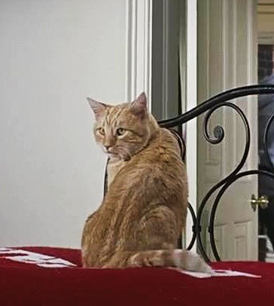
The Cat
Is Holly's innocence

Slide 13
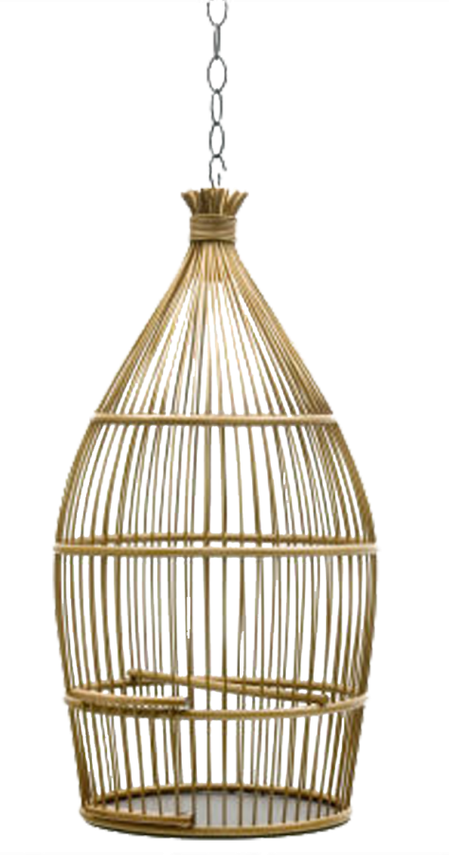
The Cage
Is the reality that Holly tried to escape from, also is the prison in her mind

Slide 14
Through these three metaphors, Capote gave us an attitude to life and love.

Slide 15

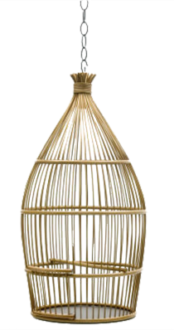
Translation
"You know what's wrong with you, Miss Whoever-you-are? You're chicken, you've got no guts. You're afraid to stick out your chin and say, "Okay, life's a fact, people do fall in love, people do belong to each other, because that's the only chance anybody's got for real happiness." You call yourself a free spirit, a "wild thing," and you're terrified somebody's gonna stick you in a cage. Well baby, you're already in that cage. You built it yourself. And it's not bounded in the west by Tulip, Texas, or in the east by Somali-land. It's wherever you go. Because no matter where you run, you just end up running into yourself.“
Paul Varjak

Slide 16
“无名小姐，你知道你的问题在哪吗？你怯懦，你没有勇气，你害怕挺起胸膛说：“是的，生活就是这样。人们相爱，互相属于对方，因为这是获得真正快乐的唯一机会。”你自称你有一个自由的灵魂，是一个“野东西”，却害怕别人把你关在笼子里，其实你已经身在笼子里了，这是你亲手建起来的，不管你在西方还是在东方，它都会一直紧随着你，不管你往哪去，你总受困于自己。”

Slide 17


 Exercises
1. Decide whether the following statements about Holly Golightly are true (T), false (F) or not given (NG).
Holly's calling card suggests that she "travels" as a way of escaping the deathlike boredom of conventional existence.
Holly Golightly earned her living through conventional means.

Slide 18



Holly Golightly distinctive characteristics were the product of her conscious self-fashioning.
Holly Golightly began to learn to play Guitar and sing from her early childhood.
Holly Golightly, a fictional person of her own making, was a woman who sold her time, affections, and even her body for money.

Slide 19

2. Choose the best answer to each of the following questions.
1) According to her mailbox , what is "Holly" short for?
A. Hollywood B. Holcomb C. Holiday D. Holly Mae

Slide 20

2) Why does Holly ring Mr. Yunioshi's bell?
She wasn't given a key.
She wishes to talk to him.
She enjoys bothering him.
She lost her key.

Slide 21

3) How old is Holly when the narrator first meets her?
A. 17 B. 18 C. 19 D. 20

Slide 22

4) What is the name of the man accompanying Holly the first night the narrator sees her?
A. O.J. Berman B. Rusty Trawler C. Harry Arbuck D. Sid Arbuck

Slide 23

5) What can be inferred from Holly’s saying "The next time a girl wants a little powder-room change, take my advice, darling: don't give her twenty-cents"?
She made living as a companion to various wealthy and important men, who lavished her with money and expensive presents.
She knew various wealthy and important men, who always lavished her with money and expensive presents.
She thought the most terrifying mean man was the one who only gave her twenty-cents.
She thought it an insult to receive money from men all together and even a small amount of money would discomfort her.

Slide 24

6) Holly is rarely without her______.
A. cat B. red carnation C. martini shaker D. dark glasses

Slide 25
7) What is "21"?
A. A dancehall B. A gay bar C. Holly's address D. A restaurant

Slide 26

8) When the narrator walked down Third Avenue to Fifty-first Street, what attracted his attention?
A birdcage in a shop window.
Talkative parrots in a shop window.
P. J. Clark's saloon.
Miss Golightly

Slide 27

9) What brand of cigarettes does Holly smoke?
A. Minarets B. Picayunes C. Picadillos D. Virginia Slims

Slide 28

10) Why did the tune with words “Don't wanna sleep, Don't wanna die, Just wanna go a-travelin' through the pastures of the sky” seem to gratify Holly most?
Because it presented her strong yearning for security and home.
Because it presented her rural roots of which she was very proud.
Because it presented her notion that travel was an alternative to confinement and death.
Because it presented her talent as an excellent country song composer.

Slide 29
3. Complete the following passage with the words given in the box. Pay attention to Capote’s narrative technique.
nameless observer objectivity directly frame crucial characteristics Fascinated watches unconventional

Slide 30






The excerpt of Breakfast at Tiffany's exits the 1)______ narrative of the introduction of Holly and moves into the central story of the narrator's relationship with Holly. Capote develops several of Holly's unique 2)______, namely, her ambiguous identity, her 3)______ sexual politics, and her artifice (打扮). To a lesser extent, the narrator is also elaborated as a character. 4)______ by Holly, he gathers details about her through anonymous surveillance: he secretly 5)______ Holly out on the town and on her fire escape, and he investigates her trash. While Holly's is the narrator's story to tell, he is outside it, an 6)______ looking in on Holly's life.

Slide 31




The narrator is thus established as a passive person, a writer who learns by observing others, rather than experiencing life 7)______. Moreover, he remains 8)______ (except to Holly, who calls him by her brother's name, Fred). Nameless, without qualities except those of the observer, the narrator of Breakfast at Tiffany's is the epitome(缩影) of the objective, "all-seeing eye" of third-person realist fiction. The narrator's struggle to maintain his writer's 9)"______" in the face of his increasing personal investment in others is 10)______ to the novella, and to Capote's work in general.

Slide 32
4. Answer the following questions.
What kind of person do you think Holly Golightly is according to what’s written on her calling card: "Holiday Golightly: Traveling"?
Do you like Holly Golightly? Why or why not?

Slide 33
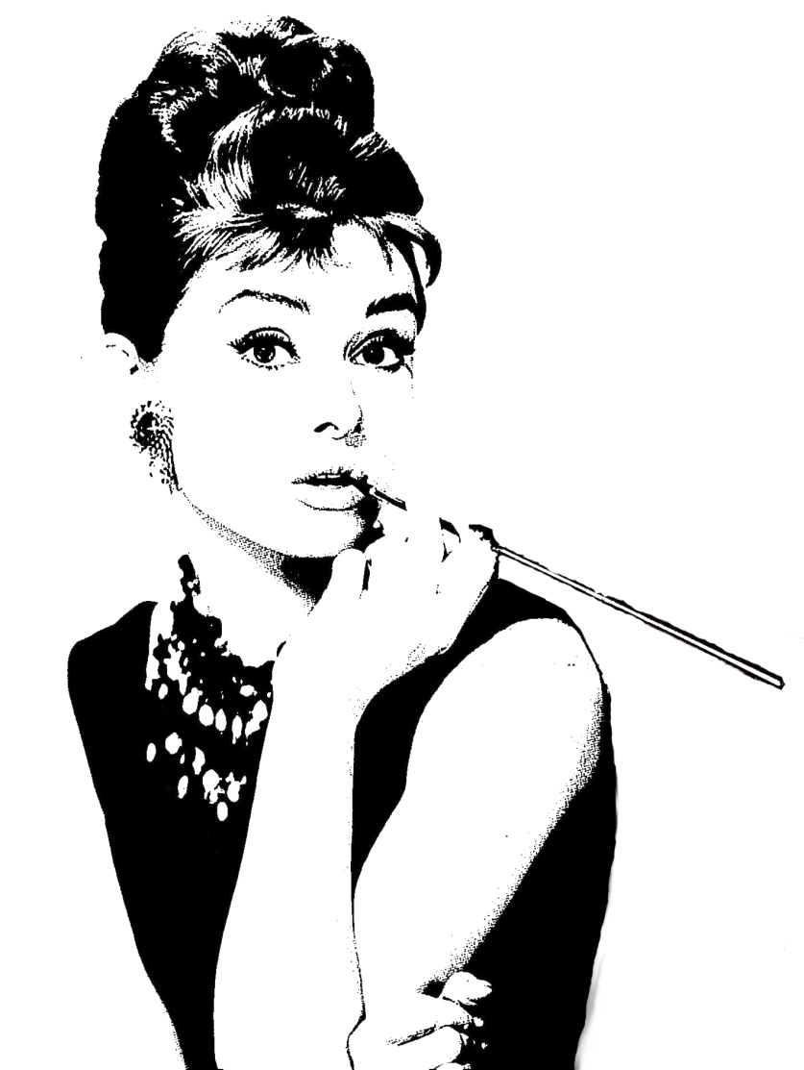
Holly Golightly Demerits
conceited, vain (fashion icon, keep track of wealthy men)
not very considerate (intrudes on other people’s lives at will )
not very ethical, lacking strong beliefs about right and wrong (Xingxing drug pusher)
impulsive, not sensible (married at the age of 14)
poor money management (bank account is not on rise)
capricious (often changes their mind unexpectedly)

Slide 34
Holly Golightly Merits
beautiful , charming
witted, interesting
resilient, courageous
simple, naïve, sincere
in pursuit of self-knowlege
19
has a perspective for life
keeps making various attempts to attain her goal
imperfect, approachable, real
dream-maker

Slide 35
The end of the story in the movie is different from that in the book, which one do you prefer?

Slide 36
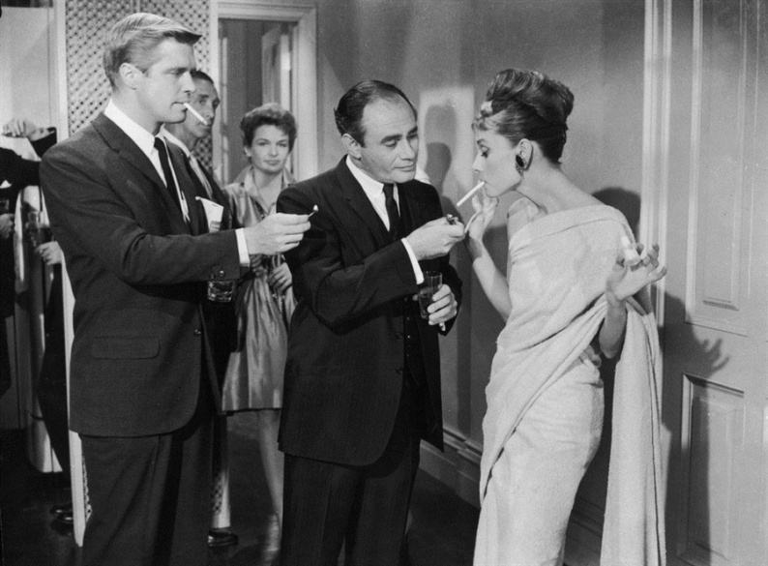
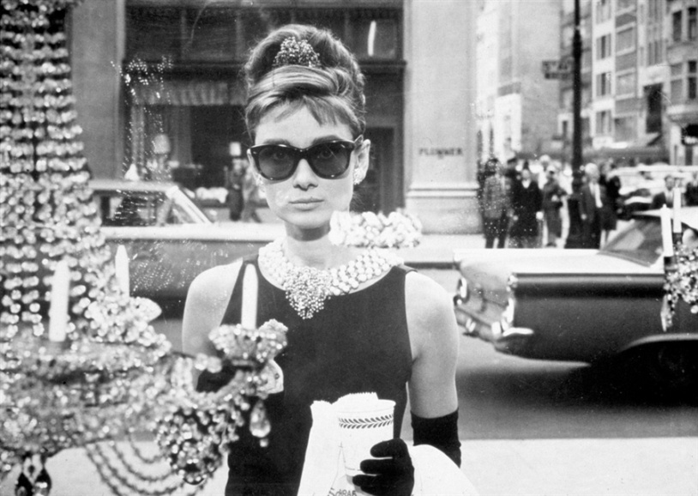
Repeat the story using the following expressions:
Tiffany & Co.; strives to be; a rich Brazilian; get married for money; end one's relationship with; decide on one's love for; released on bail; arrested by police; releases the cat from the taxi; confront sb. about his/her behavior; engrave; examine one's life; look into each other's eyes and embrace
Notes:
Repeat the story using the following expressions:
Repeat the story using the following expressions:

Slide 37
Thank You

